Slide 1
HANDWRITTEN DIGIT IDENTIFICATION
TS. Nguyễn Tấn Trần Minh Khang
ThS. Trần Minh Tùng
ThS. Võ Duy Nguyên
Phạm Thị Hoàng Mai

Slide 2
MNIST DATASET

Slide 3
Introduction
The MNIST database of handwritten digits, has a training set of 60,000 examples, and a test set of 10,000 examples.
The digits have been size-normalized and centered in a fixed-size image.

Slide 4
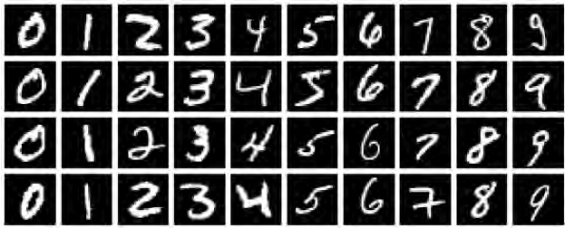
Introduction
Sample images

Slide 5
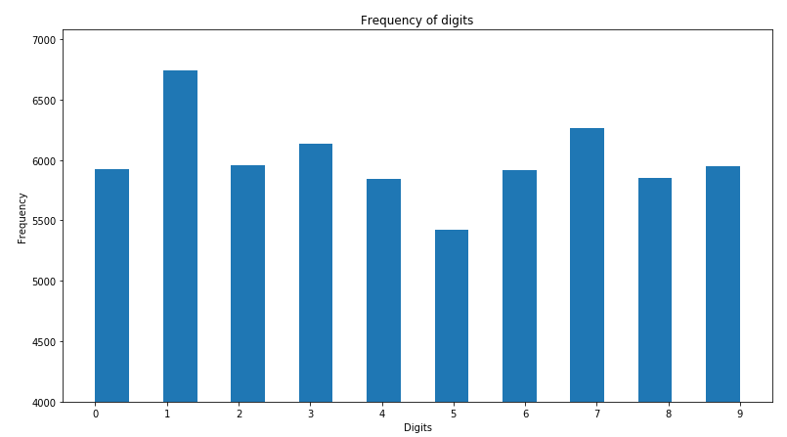
Training set

Slide 6
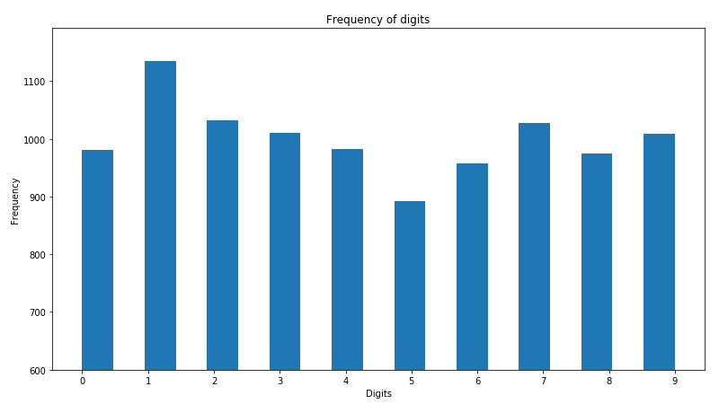
Test set

Slide 7
k-nearest neighbors classifier

Slide 8
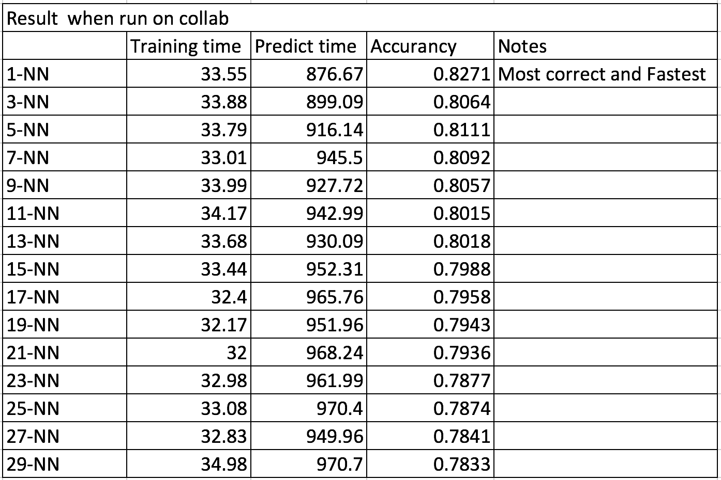
Result

Slide 9
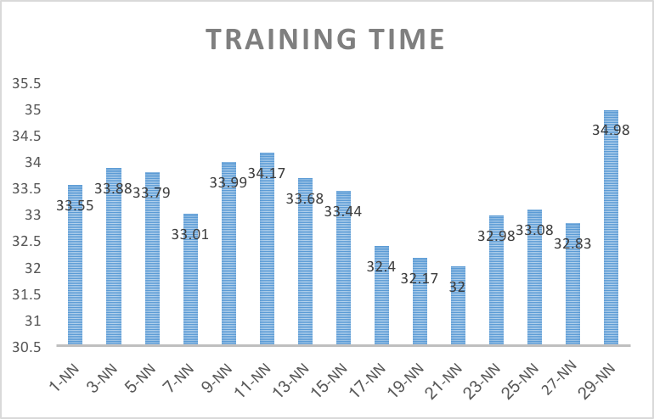
TRAINING TIME

Slide 10
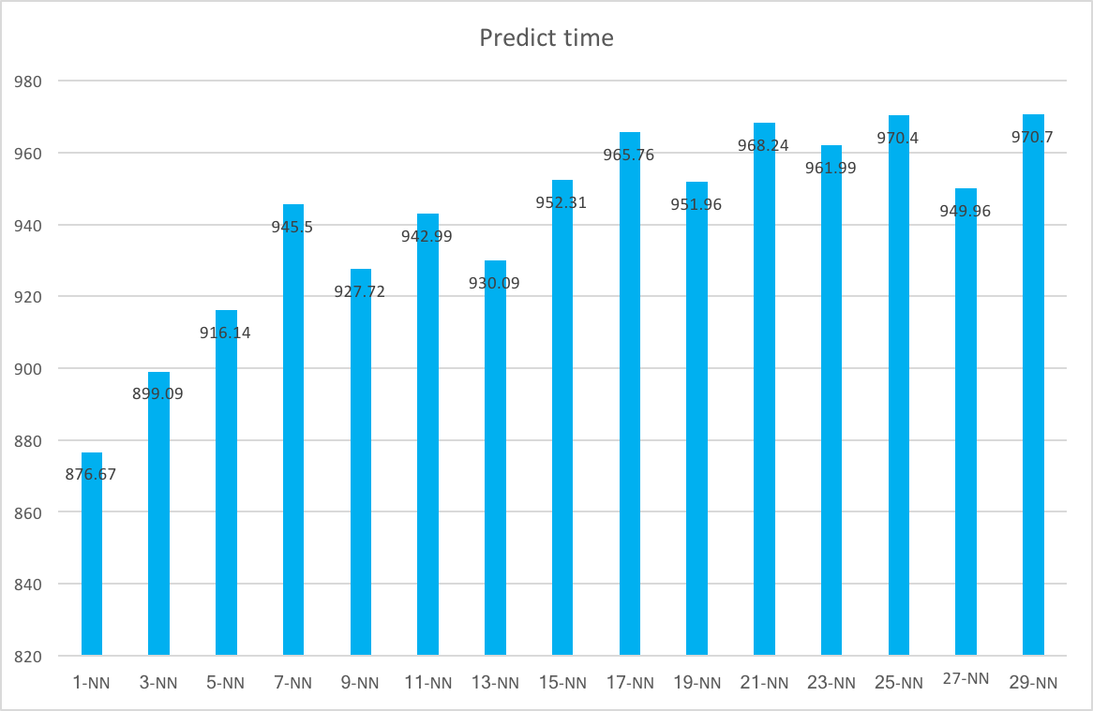
Predict time

Slide 11
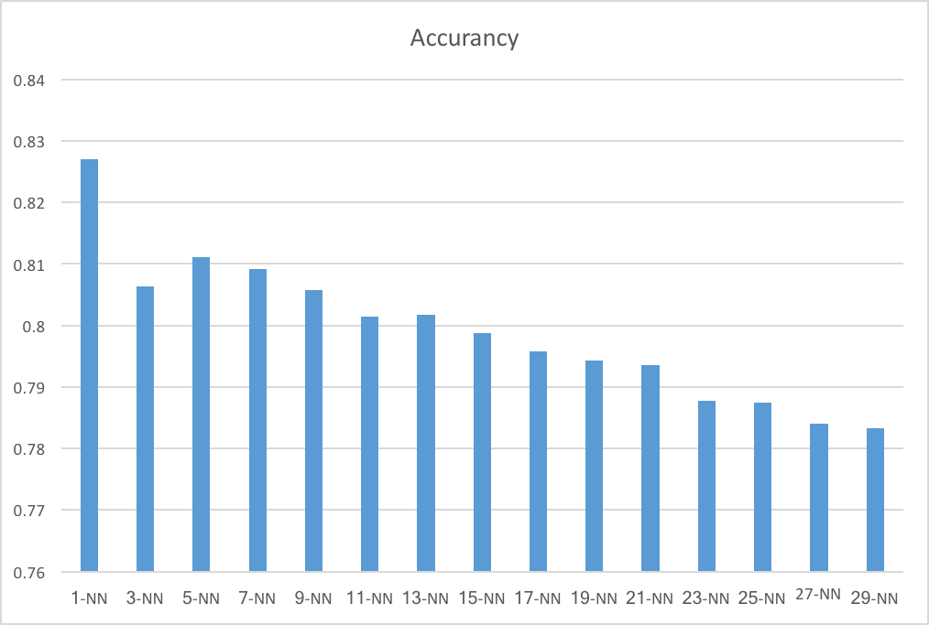
Accuracy

